Slide 1

Project Presentation Tarun Kumar CHopra
Predicting Bank Failure: An Improvement by Implementing a Machine-Learning Approach to Classical Financial Ratios

Slide 2
Content Slide
Problem & Challenges
Motivation
Existing related approaches
The method(that you duplicate)
Results and observation
Conclusion & future work

Slide 3
Problem & Challenges
Data availability
Data quality
Imbalanced data
Feature selection
Model complexity
Regulatory constraints

Slide 4
Motivation
machine learning models for predicting bank failure can provide a valuable tool for financial institutions and regulators to monitor and manage risk, protect customers, and maintain economic stability.
Early warning system
Risk management
Regulatory compliance
Customer protection
Economic stability

Slide 5

Existing related approaches
Neural networks
Gradient boosting
Random forest
Decision trees
Logistic regression
Support vector machines (SVMs)
Overall, there are several machine learning approaches that can be used to predict bank failure, each with their strengths and weaknesses. The choice of approach will depend on the specific characteristics of the dataset and the desired level of accuracy and interpretability.

Slide 6
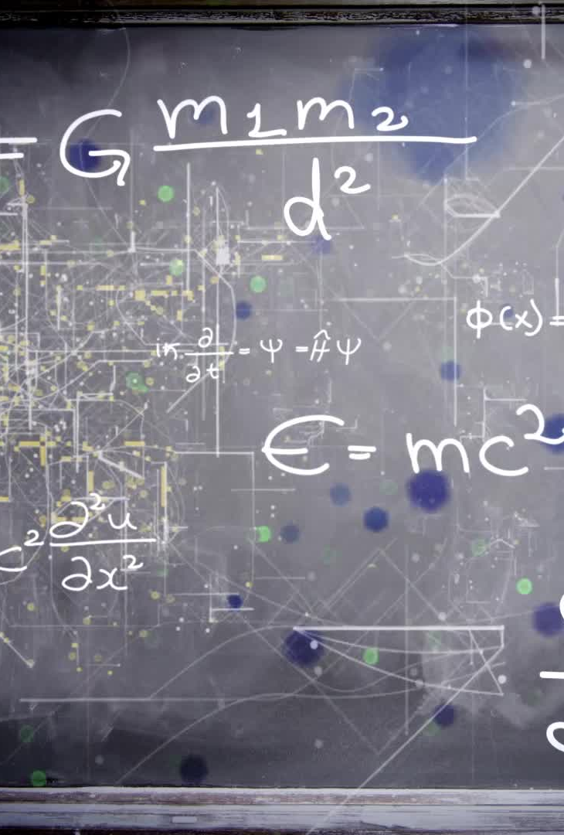
The method(that you duplicate)
SGDClassifier
Support vector Machine
LogisticRegression
KNeighborsClassifier
GaussianNB
KerasClassifier ( Neural Network)

Slide 7
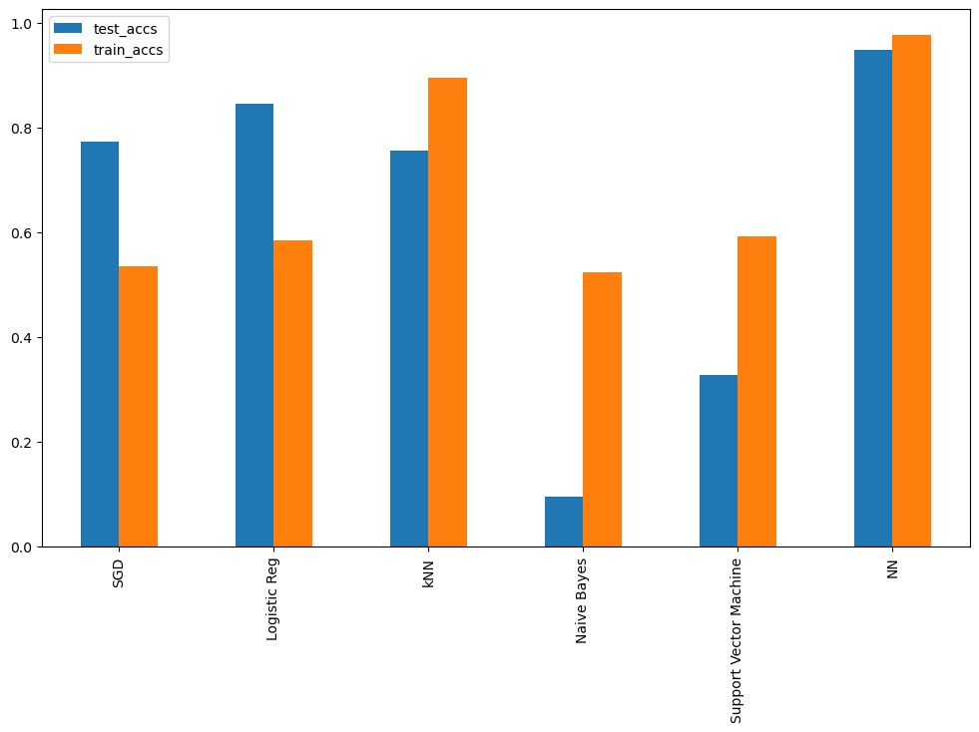
Results and observation
After comparing 6 different models for predicting bank failure KerasClassifier (Neural Networks) shows best results.
Logistic regression and SGD produce better test acuracy as well

Slide 8

Conclusion & future work
This result clearly shows that KerasClassifier shows best results but parameter optimization like learning rate for all other Models could improve performances and accuracy of predictions , so that could be explored

